Slide 1
Mini Project Presentation
Title: Youtube Transcript Summarization
Team:Kesavan,Kiruba Shankar

Slide 2
Content:
Abstract
What is Natural Language Processing(NLP)
Modules Used
HuggingFace
Sample Model
Conclusion

Slide 3
Abstract:
On YouTube, lots of videos are uploaded every single day around the world which are very long, mostly educational Related Videos. And if We want to find some useful information from those videos, it is an almost impossible task to achieve since most of the videos contain so much useless content and less useful content, because of this you have to watch the whole video which probably wastes Our lots of time and efforts or watch multiple videos to extract that useful information .
So , generating the summaries of those video transcripts will save Our lots of time and We can quickly gather more useful and important information from it .
The project which we are going to do is extracting the summaries from a video transcripts and also generating important keywords from it which will use Natural Language Processing (NLP) methods for extractive and abstractive summarization .

Slide 4
Natural Language Processing(NLP):
Natural Language Processing (NLP) is a field of Artificial Intelligence that focuses mainly on the study of the interaction between human languages and machines.
Natural language processing strives to build machines that understand and respond to text or voice data—and respond with text or speech of their own—in much the same way humans do.
Tokenization is breaking the raw text into small chunks. Tokenization breaks the raw text into words, sentences called tokens. These tokens help in understanding the context or developing the model for the NLP. The tokenization helps in interpreting the meaning of the text by analyzing the sequence of the words
7 techniques Natural Language Processing (NLP) uses to extract data from text are:
Sentiment Analysis, Named Entity Recognition, Summarization, Topic Modeling, Text Classification, Keyword Extraction, & Lemmatization and stemming.

Slide 5
Modules Used:
Transformers: Transformers provides APIs to easily download and train state-of-the-art pretrained models. Using pretrained models can reduce your compute costs, carbon footprint, and save you time from training a model from scratch
Youtube_transcript_api: This is an python API which allows you to get the transcripts/subtitles for a given YouTube video. It also works for automatically generated subtitles, supports translating subtitles
Ipython:IPython provides a rich toolkit to help you make the most of using Python interactively. Its main components are: A powerful interactive Python shell
Pipeline: Pipelines function by allowing a linear series of data transforms to be linked together, resulting in a measurable modeling process

Slide 6
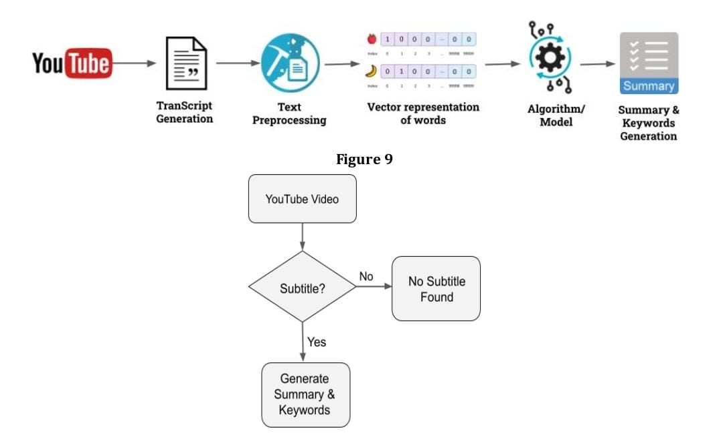
HuggingFace:
The HuggingFace is an immensely popular Python library providing pretrained models that are extraordinarily useful for a variety of natural language processing (NLP) tasks. It previously supported only PyTorch, but, as of late 2019, TensorFlow 2 is supported as well.

Slide 7
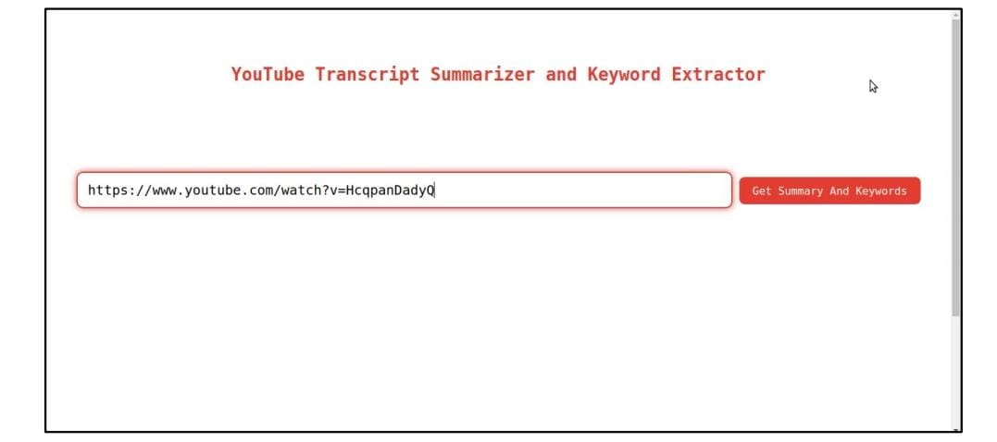
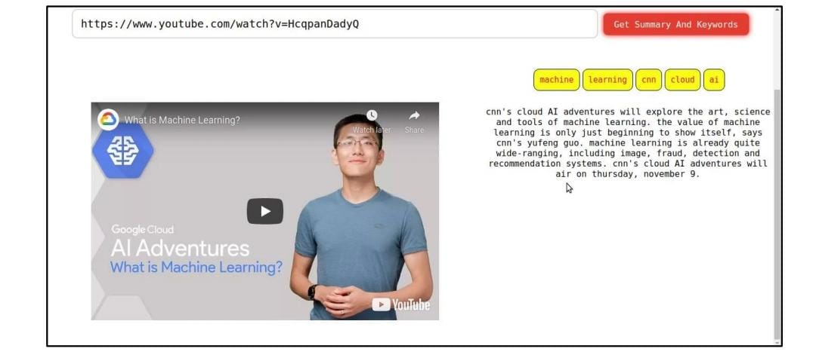
Sample Model:
Result:

Slide 8
Conclusion:
As a conclusion, The project which we are going to do is extracting the summaries from a video transcripts from it which will use Natural Language Processing (NLP) methods for extractive and abstractive summarization.

Slide 9
THANK YOU !
BY.
PR.KESAVAN
AP.KIRUBA SHANKAR

